Slide 1
Text Analytics – Extra Case Study and Notes
Module 4 Data Analytics and Visualization

Slide 2
Text Mining Example – FDA Recall Data
Data: Medical Device Recall Data from fda.gov
Objective: Use text mining to summarize issues in medical device recalls.
Software used: SAS/JMP script with R.
‹#›

Slide 3
INTRODUCTION
‹#›

Slide 4
What is Text Mining?
Text mining relies on several disciplines
Statistics
AI and Machine Learning
Data Mining
Database Management
Library and Information Sciences
Computational Linguistics
Information Technology
‹#›

Slide 5
Extracting Numerical Representations of Text
In order to analyze text in a systematic and structured way, we first need to develop a numerical representation of the text.
Obviously, there is not a unique solution to this problem. The appropriate mapping of text->numbers depends on the goal of the study.
‹#›

Slide 6
How is Text Mining Similar to Data Mining
Once we have extracted numerical summaries of the documents, we will rely on existing statistical and machine learning methods to process the information.
However, these summaries have special properties that need to be recognized. As such, text mining is a deeper topic than just finding a mapping of text to numbers.
‹#›

Slide 7
How is Text Mining Different from Data Mining
Focusing on syntax instead of semantics, the standard approach for representing a collection of documents is with a matrix with documents as rows and terms as columns.
As an analogy to other data mining problems, think of documents as observations and terms as variables.
This matrix will typically be extremely large, yet sparse.
The nonzero entries of the matrix are all positive.
Overlaps of nonzero components in two documents are more informative than overlaps of zero components.
There will not be any missing data.
Long documents will have larger term counts than short documents.
Different transformations of this matrix are used in practice.
‹#›

Slide 8
Evolution of Text Mining
Early motivation: cataloging library books and articles.
Dewy Decimal System (1876)
Summarizing scientific documents with abstracts (1898)
Computer-generated abstracts (1958)
Discussion of classifying library books by word frequencies (1961)
Gary Miner, et al. Practical Text Mining and Statistical Analysis for Non-structured Text Data Applications. Academic Press: Oxford, 2012.
‹#›

Slide 9
Development of Enabling Technology
Graphical capabilities.
– Software is now widely available for plotting labeled points while minimizing overlap in the labels in 2- or 3-D.
Gary Miner, et al. Practical Text Mining and Statistical Analysis for Non-structured Text Data Applications. Academic Press: Oxford, 2012.
‹#›

Slide 10
Development of Enabling Technology
Reduction of Dimensionality and Feature Selection.
Processing text is a high-dimensional problem, even in applications where grammatical structure is ignored.
Computational developments have improved the scalability of text mining applications.
Sparse matrix methods have improved memory requirements and sped up computations.
The singular value decomposition has been extremely useful for reducing the dimensionality of problems.

Slide 11
Seven Practice Areas of Text Mining
Search and information retrieval (IR)
Document clustering
Document classification
Web mining
Information extraction (IE)
Natural language processing
Concept extraction

Slide 12
Problems TM Can Address
Predicting the probability an insurance claim is fraudulent based on the text in the claim
Filtering spam
Producing a list of documents (e.g. emails, error reports) that are most similar to one of interest. Might be useful in an audit, or if you work for the NSA
Obtaining a fast, yet representative, summary of the topics in a collection of documents
Finding which types of aviation accidents are most strongly associated with the presence of fatalities
Putting out-of-spec incident reports from process engineers to use (instead of not using them at all)
Evaluating customer sentiment about new product releases (Twitter, focus groups, complaints, etc.)
Determining authorship
Sentiment analysis
Trend analysis: what are the most common themes in the abstracts at a major statistics conference this year? What were they in 2003?

Slide 13
Text Mining Example – Inspection Observations
Data: Inspection observations from fda.gov.
Objective: Determine the most frequent themes in inspection observations for a particular industry (medical device, drugs, biologics).
Software used: SAS/JMP script with R.

Slide 14
NTSB Example
In this section, we will occasionally use data from a collection of National Transportation Safety Board aviation accident reports to illustrate a concept
The documents in this corpus consists of short descriptions of the cause of each accident.
The data are available from Weiss, S., et al. (2009) Text Mining: Predictive Methods for Analyzing Unstructured Information

Slide 15
Text Mining Example – NTSB Aircraft Accident Reports
Data: NTSB Aircraft Accident Reports.
Objective: Determine what factors contributed to fatal accidents.
Software used: SAS/JMP script with R.
Gary Miner, et al. Statistical Analysis and Data Mining. Academic Press: Amsterdam, 2009.

Slide 16
String Processing
Car Accidents
Slid on ice into a curb.
Driving too fast in a dust storm, hit the curb.
Low-budget tires failed after bumping curb.
We will use the three car accident descriptions above to illustrate text processing.

Slide 17
Bag of Words Approach
Using a “bag of words” approach, we disregard the ordering of the words in each document as well as their grammatical properties.
While this may seem simplistic, it has been shown to give excellent results in many applications.

Slide 18
Vocabulary
Document: a string of words.
Corpus: a collection of documents.
In the text mining literature, “words,” “terms,” and “tokens” all describe roughly the same idea. There are some subtleties to their use: we will use them interchangeably to mean words that have been extracted from a document and processed.

Slide 19
Processing Text
Within each document, we will first
Isolate individual words
Remove punctuation
Normalize case (convert all characters to lowercase)
Remove numbers
Later, we will discuss further processing of the words.

Slide 20
Isolate Words
Document 1 | Document 2 | Document 3
Slid | Driving | Low-budget
on | too | tire
ice | fast | failed
into | in | after
a | a | bumping
curb. | dust | curb.
 | storm,
 | hit
 | the
 | curb.
Notice that punctuation is concatenated to adjacent terms.

Slide 21
Remove Punctuation
Document 1 | Document 2 | Document 3
Slid | Driving | Lowbudget
on | too | tire
ice | fast | failed
into | in | after
a | a | bumping
curb | dust | curb
 | storm
 | hit
 | the
 | curb

Slide 22
Normalize Case
Document 1 | Document 2 | Document 3
slid | driving | lowbudget
on | too | tire
ice | fast | failed
into | in | after
a | a | bumping
curb | dust | curb
 | storm
 | hit
 | the
 | curb

Slide 23
NATURAL LANGUAGE PROCESSING
‹#›

Slide 24
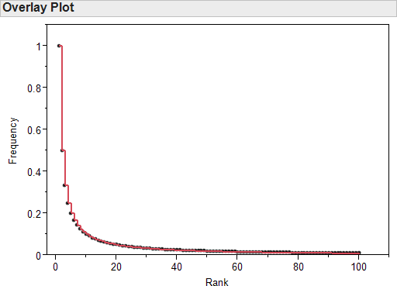
Zipf’s Law and Term Frequency Counts
When counting frequency of terms in a corpus, the frequency of a word will be roughly proportional to its rank.
‹#›

Slide 25
Practical Implications of Zipf’s Law
The matrix that contains the documents (in rows) and terms (in columns) is called the document- term matrix (DTM).
The DTM is sparse: with the majority of terms only appearing a few times, most entries in the DTM will be 0.
A small collection of words occur so frequently (and likely in so many documents) that they do not give any discriminating power. These are referred to as stopwords.
‹#›

Slide 26
Finding the Important Terms
Stopwords occur so frequently that they are uninformative.
A large proportion of infrequent words will either be typos or appear in so few documents that they are not useful in detecting patterns.
Typically, there will be a handful of medium frequency words that provide the most flexibility in differentiating between the document themes.
‹#›

Slide 27
Natural Language Processing
After extracting the tokens from a document, it is typically useful to
Remove stopwords (most frequent words).
Stem the text.
Remove words with character length below a minimum or above a maximum.
Remove words that appear in only a few documents (most infrequent words).
‹#›

Slide 28
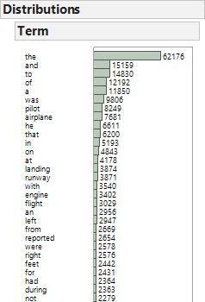
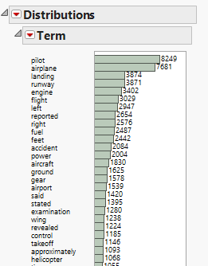
Stopwords
‹#›

Slide 29
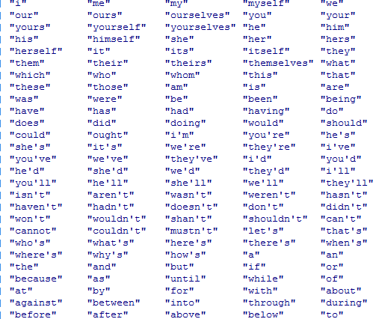
Stopwords
A partial list of common stopwords appears below. All text mining software packages will have a list of common English stopwords that may be used.
‹#›

Slide 30
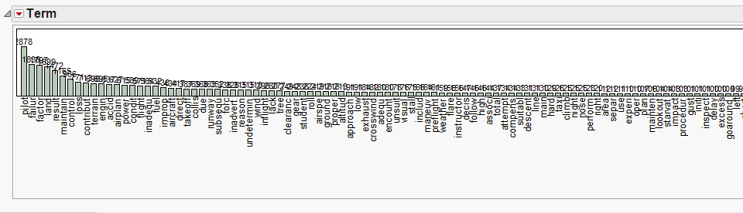
Term Frequency
The drop-off in term frequencies will not be as pronounced as the one predicted by Zipf’s law if stopwords have been removed, as they have been in this example.
‹#›

Slide 31
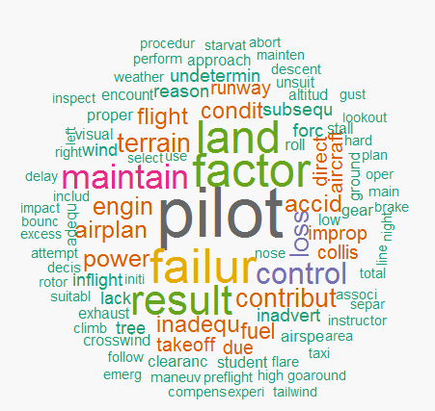
Wordcloud
A wordcloud displays the most frequent terms in a corpus in the center of the cloud. Terms get smaller and move away from the center (and are color-coded) as they become less frequent. The orientation of the term is irrelevant in this example.
‹#›

Slide 32
Custom Stopwords
In each application, there will likely be a set of frequent words that appear in most documents.
For example, in a collection of reports about airplane accidents, the words “airplane”, “plane”, and “aircraft” may be specified as custom stopwords.
In other cases, the generic stopword list may remove too many terms.
‹#›

Slide 33
Custom Stopwords
Optionally, a column of custom stopwords may be given to the script.
These do not need to be individual words: a phrase of words separated by spaces may be entered into a single cell of the custom stopwords column
The script searches for and removes words from this list at three separate points during the execution of the script
Before the documents have been processed
After the punctuation has been removed and the text converted to lower case
After the terms have been stemmed

Slide 34
Remove Stopwords
Document 1 | Document 2 | Document 3
slid | driving | lowbudget
ice | fast | tire
curb | dust | failed
 | storm | bumping
 | hit | curb
 | curb

Slide 35
Stemming Text
“The computer is saving the table.”
“The computers saved the tables.”
After removing stopwords, these documents are reduced to
computer saving table
computers saved tables
Even though these documents are conveying the same idea, they have no words in common and would not be recognized as similar.

Slide 36
Stemming Text
Stemming effectively chops the endings off of words. Plural and singular nouns are reduced to the same token, and conjugated verbs are also reduced.
After stemming, the sentences from the last slide become:
comput save tabl
comput save tabl
The documents are now recognized as identical.
As a further example, the next slide will contain the stemmed text from this slide (with stopwords removed).

Slide 37
Stemming Text
stem effect chop end word plural singular noun reduc token conjug verb also reduc
stem sentenc last slide becom
comput save tabl
comput save tabl
document now recogn ident
exampl next slide will contain stem text slide stopword remov

Slide 38
Stem Text
Document 1 | Document 2 | Document 3
slid | drive | lowbudget
ice | fast | tire
curb | dust | fail
 | storm | bump
 | hit | curb
 | curb

Slide 39
Other Processing Options
Remove numbers: may not want to if part numbers or important identifiers are present.
Filtering out words by character length
With the exception of chemical names, the longest non- coined, non-technical English word is 28 letters (Wikipedia).
Anything longer is likely to be a web URL or a string of garbled text (common when converting PDF to text).
Removing words that appear in only a few documents.
Words that appear in only 1 document give no discriminating power. Removing them reduces computational requirements. May also want to remove words that appear in only a handful of documents.

Slide 40
Representing Text with Numbers
To find clusters of documents or to use the information present in the documents in a predictive model, we need a numerical representation of the text.
Using the bag of words approach, we create a document term matrix (DTM). Each document is represented by a row, and each token is represented by a column. The components of the matrix represent how many times each token appears in each document.

Slide 41
Document Term Matrix
Doc | bump | curb | drive | dust | fail | fast | hit | ice | lowbud get | slid | storm | tire
1 | 0 | 1 | 0 | 0 | 0 | 0 | 0 | 1 | 0 | 1 | 0 | 0
2 | 0 | 1 | 1 | 1 | 0 | 1 | 1 | 0 | 0 | 0 | 1 | 0
3 | 1 | 1 | 0 | 0 | 1 | 0 | 0 | 0 | 1 | 0 | 0 | 1

Slide 42
Properties of the DTM
The DTM will typically be very sparse (most entries are 0).
Even for modestly sized applications, the full DTM will be too large to hold in memory.
Since most entries are 0, multiplying the matrix results in several multiplications by 0, which could be omitted.
Special software and algorithms are available for storing and manipulating sparse matrices.

Slide 43
Transformations of the DTM
Frequency (local) weights
Binary: Useful if there is a lot of variance in the lengths of the documents in the corpus.
Ternary/Frequency: Some researchers have found that distinguishing between terms that appear only once in a document vs. those that appear multiple time can improve results.
Log: Dampens the presence of high counts in longer documents without sacrificing as much information as the binary weighting scheme.

Slide 44
Transformations of the DTM
Term (global) weights
Term Frequency - Inverse Document Frequency (tf-idf)
Shrinks the weight of terms that appear in many documents while also inflating the weight of terms that appear in only a few documents
Sometimes makes interpretation of results more difficult, but can give better predictive performance. In practice, it is best to try different weighting schemes: there is no need to pick only one!

Slide 45
Transformations of the DTM
Normalizing each document
The term frequency weights in each document may be normalized so that the sum of each document vector is 1. This is done by dividing the term counts in each document (each row of the DTM) by the total number of words in each document (the row sums of the DTM)
This can be useful when the documents are of different lengths. An illustration of how this can help: if a document D’ is created by pasting two copies of a document D together, D and D’ will be identical after normalization.

Slide 46
Normalized Term-Frequency Document Term Matrix
Doc | bump | curb | drive | dust | fail | fast | hit | ice | lowb udget | slid | storm | tire
1 | 0 | 0.333 | 0 | 0 | 0 | 0 | 0 | 0.333 | 0 | 0.333 | 0 | 0
2 | 0 | 0.167 | 0.167 | 0.167 | 0 | 0.167 | 0.167 | 0 | 0 | 0 | 0.167 | 0
3 | 0.2 | 0.2 | 0 | 0 | 0.2 | 0 | 0 | 0 | 0.2 | 0 | 0 | 0.2

Slide 47
Term Frequency-Inverse Document Frequency
Terms that appear in most documents give little discriminating power (hence the removal of stopwords).
To address this, we multiply the term frequencies by an inverse document frequency, which down-weights words that appear in many documents.

Slide 48
Inverse Document Frequency
idf down-weights terms that appear in many documents. The idf for term t is
𝐷
𝑖𝑖𝑑𝑓𝑓_{𝑡} = log₂
𝑑𝑓𝑓_{𝑡}
D is the number of documents in the corpus.
𝑑𝑓𝑓_{𝑡} is the number of documents containing term t.
If a term appears in every document, its idf is 0.

Slide 49
Term Frequency – Inverse Document Frequency
After calculating the inverse document frequencies (one for each term), we multiply the term frequency entries of the DTM by the appropriate idf.
For example, the tf entry for curb in Document 1 is 1, since curb appears once in Document 1. However, the inverse document frequency of
3
curb is 𝑙𝑜𝑔 = 0. Thus the tf-idf entry for
3
curb in Document 1 is 0.

Slide 50
tf-idf
Doc | bump | curb | drive | dust | fail | fast | hit | ice | lowbud get | slid | storm | tire
1 | 0 | 0 | 0 | 0 | 0 | 0 | 0 | 1.585 | 0 | 1.585 | 0 | 0
2 | 0 | 0 | 1.585 | 1.585 | 0 | 1.585 | 1.585 | 0 | 0 | 0 | 1.585 | 0
3 | 1.585 | 0 | 0 | 0 | 1.585 | 0 | 0 | 0 | 1.585 | 0 | 0 | 1.585

Slide 51
Wordcloud
A wordcloud displays the most frequent terms in a corpus in the center of the cloud. Terms get smaller and move away from the center (and are color-coded) as they become less frequent. The orientation of the term is irrelevant in this example.

Slide 52
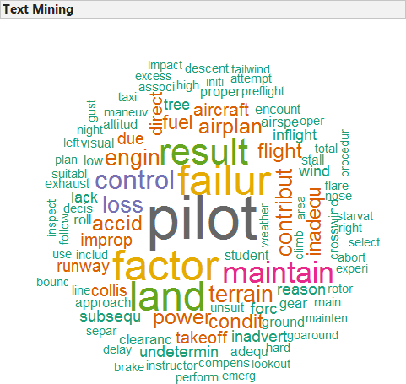
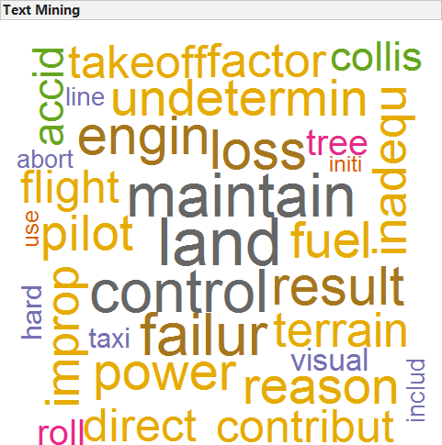
Wordcloud depends on Frequency Weighting
Term Frequency
tf-idf

Slide 53
Frequency Weighting Summary
There is no universally best weighting: take time to try different options.
The following slides provide an additional example of how the different weighting schemes compare to the raw frequency counts.

Slide 54
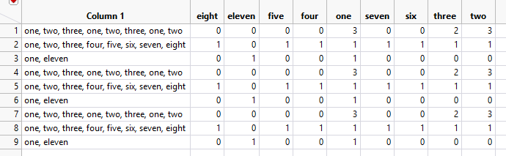
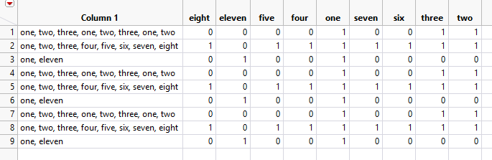
Binary

Slide 55
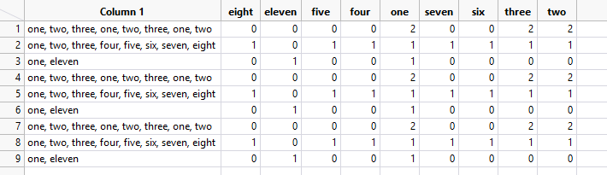
Ternary

Slide 56
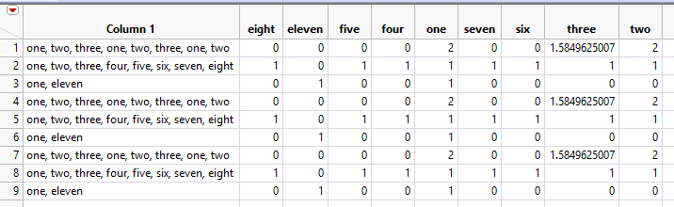
Log

Slide 57
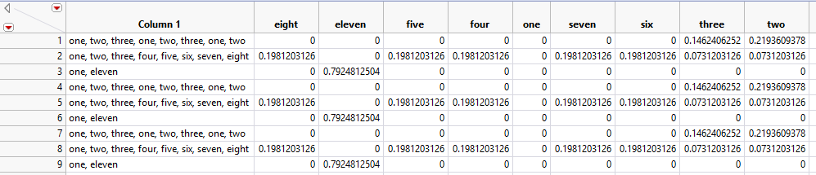
tf(normalized)-idf

Slide 58
APPLICATIONS OF TEXT MINING
‹#›

Slide 59
Web Crawler – FDA Recalls
Data: FDA Recall data.
Objective: Crawl fda.gov to develop a corpus of recalls for a specified year.
Software used: SAS/JMP script with R.
‹#›

Slide 60
Text Mining Example – Recall Data
Data: Medical device recall data from fda.gov.
Objective: Develop a corpus of recalls from a folder of text documents (for a specified company and year).
Software used: SAS/JMP script with R.
‹#›

Slide 61
Text Mining Example – Recall Data
Data: Medical device recall data from fda.gov.
Objective: Use text mining to summarize issues in medical device recalls for a specified year.
Software used: SAS/JMP script with R.
‹#›

Slide 62
Text Mining Example – Recall Data
Data: Medical device recall data from fda.gov.
Objective: Use text mining to summarize issues in medical device recalls for a specific company in a specific year.
Software used: SAS/JMP script with R.
‹#›

Slide 63
Text Mining Example – Inspection Observations
Data: Inspection observations from fda.gov.
Objective: Determine the most frequent themes in inspection observations for a particular industry (medical device, drugs, biologics).
Software used: SAS/JMP script with R.
Gary Miner, et al. Statistical Analysis and Data Mining. Academic Press: Amsterdam, 2009.
‹#›

Slide 64
Text Mining Example – Inspection Citations
Data: Inspection citations from fda.gov.
Objective: Use inspection citations to determine if certain compliance themes are associated with certain companies.
Software used: SAS/JMP script with R.
Gary Miner, et al. Statistical Analysis and Data Mining. Academic Press: Amsterdam, 2009.
‹#›

Slide 65
Few More Examples
‹#›

Slide 66
Sentiment Analysis – Cars
Data: 638 car reviews written by owners.
Objective: Determine general sentiment about automobiles. Determine if general sentiments can be ‘attached’ to certain types of automobiles.
Software used: SAS/JMP script with R.
Gary Miner, et al. Statistical Analysis and Data Mining. Academic Press: Amsterdam, 2009.
119

Slide 67
Concept Extraction Example – Movies
Data: 1,527 randomly selected movie synopses.
Objective: Use text mining techniques (using the DTM) to determine if specific text strings can be used to predict box office success.
Software used: SAS/JMP script with R.
Text Analytics Using SAS® Text Miner. SAS Institute: Cary, 2011.
‹#›

Slide 68
Social Media - Twitter
Data: Live Twitter data
Objective: Determine social media reaction to a certain current event.
Software used: SAS/JMP script with R.
‹#›

Slide 69
Text Mining Example – NTSB Aircraft Accident Reports
Data: NTSB Aircraft Accident Reports.
Objective: Determine what factors contributed to fatal accidents.
Software used: SAS/JMP script with R.
Gary Miner, et al. Statistical Analysis and Data Mining. Academic Press: Amsterdam, 2009.
‹#›

